Slide 1

DATA AUGMENTATION FOR CNN MODEL
DATASET: CIFAR10

Slide 2

What is Data Augmentation
Process of taking images that are already in a training set and manipulating them to create many altered versions of same image
Advantages:
Overcome high expense of collecting training images
Expose model to wider variety of coloring/lighting situations making it more robust

Slide 3


SOME TYPES OF DATA AUGMENTATIONS
Feature Standardization
ZCA Whitening
Random Rotations
Random Shifts
Flips
Scaling
Translation
Lightening Conditions
Perspective transforms
Contrast Stretching
Adaptive Equalization

Slide 4
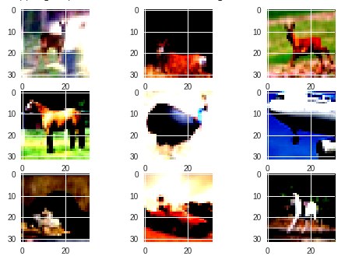
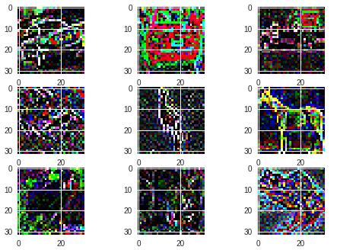
SAMPLE OF SOME IMPLEMENTATIONS IN CNN MODEL
Feature Standardization
ZCA Whitening

Slide 5
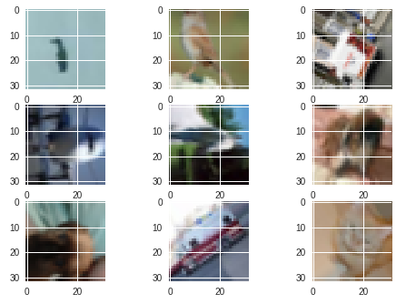
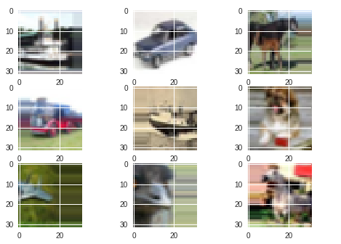
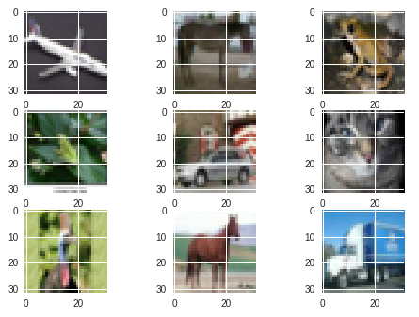
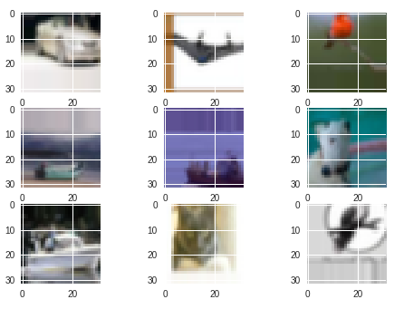
Random Rotations
Random Shifts
Flips

Slide 6
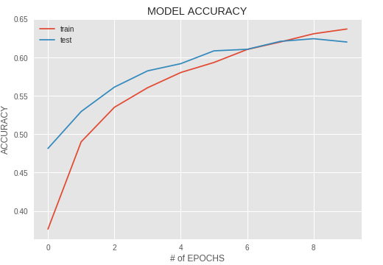
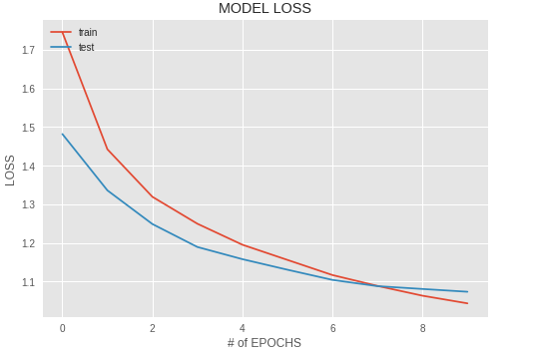

CNN MODEL PERFORMANCE BEFORE DATA AUGMENTATION
HYPERPARAMETERS SETTINGS:
Learning rate: 0.0001
Activation function: relu
Number of layers: 7
Batch Size: 32
Number of epochs: 10

Slide 7
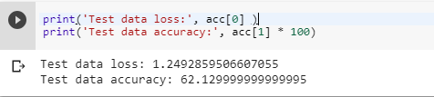
Model Performance Post Data Augmentation

Slide 8
COMPARISON
Metric | Model Without Data Augmentation | Model with Data Augmentation | Methods to Overcome Problem is any
Model Loss | It is lower | It is slightly higher when compared to model without Data Augmentation | Increasing the batch size and number of epochs could help model with Data Augmentation to improve
Model Accuracy | It is lower than the other Model | It increases when compared to Model without Data Augmentation | Increasing number of epochs could increase the Model Accuracy even more in the case of Image Augmented Model
Model Training Time | Time taken with GPU is 3.5 minutes | Time taken with GPU is 200 minutes | Machine with higher computational power is required for Model with Data Augmentation

Slide 9

INFERENCE:
Model training time is increased when Data Augmentation is applied. It takes more than twice when compared to model without data augmentation.
Time constraint is very important while choosing a model type. According to the computational power of the machine and the accuracy gap between the two models is to be observed prior choosing the right model.
It not only benefits the classification task but also improves the state of algorithm.
It also helps in situation where data available is unbalanced.
Transformed Images can be saved to file for later use as well.

Slide 10


